Slide 1



Large Scale Automated Essay Scoring
Microsoft Research Internship
Purnawirman Purnawirman
Mentor :
Henry Setiawan
Matthew Hatem
Trishul Chilimbi
Microsoft Research (Redmond), 05/23/16 – 08/12/16

Slide 2
Overview
Motivation
Literature Review
Proposed Approach
Validation
Milestones/Timelines

Slide 3
Motivation

Slide 4
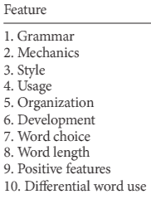
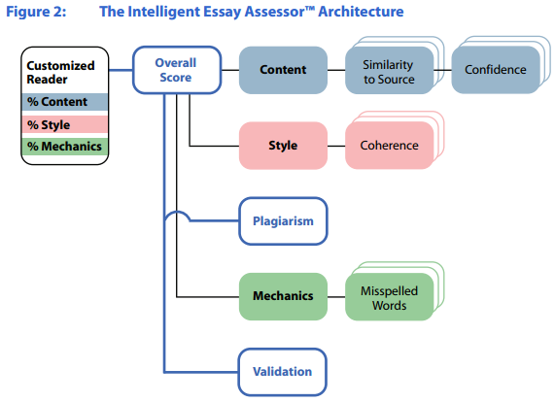
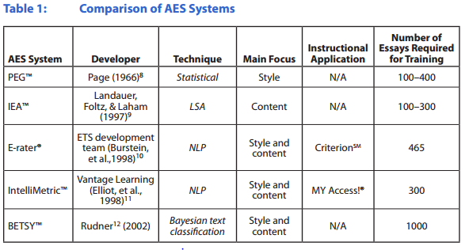
Literature Review
Classical Statistics / NLP
Machine Learning
Deep Learning
NLP approach
Require small number of training sets, but not scalable
e.g. IEATM
Feature extraction (NLP)
e.g. e-rater (2013)
Word embedding (vector representation)
Recurrent Neural Network
Recursive Neural Network (Syntax Parsing)
Regression, SVM, k-NN, RF
Scores

Slide 5
Proposed Approach
Approach
Much more reproductive choice is now available to women, with the ability to chose whether or not to have children, when to have them and in what context, now a reproductive right given to women.
This, combined with shifting social and economic opportunities for women, has lead to an increase in the number of childless women, with, in 1991, twice as many saying that they expected to remain childless as in 1986 (Gillespie, 2001). However the anticipated number of children per woman in Europe and the USA is still near or above two (Bongaarts, 1999), showing that many are still having children.
Introduced 4 types of errors:
1. Word level
Random spelling errors
Plurals, tenses, or grammatical errors
2. Sentence Level
Random ordering error e.g. (good, this sentence is not)
Random word replacements
Bad punctuation marks, short/long sentences
3. Paragraph Level
Random ordering error
Random sentence replacements (within same essay or other essays)
4. Essay Level
Random ordering error
Random paragraph replacements
Comparing different corpus
Then, map errors to scoring criteria
Word
Sentence
Paragraph
Essay
Score:
4.5/5.0

Slide 6
Validation
Validation
Map Scores:
Compare between corpus (e.g. emails, twitters should be lower than well curated corporas)
Compare with existing commercial tools, e.g. ETS and Pearson.
Compare quality from existing dataset (e.g. Wikipedia has rating systems)
…
The mapping can be as simple as weighted average, or a trained functions.
Word
Sentence
Paragraph
Essay
Mapping
Score:
4.5/5.0

Slide 7

Milestones / Timelines
05/30/16 – 06/20/16
(week 2 – week 5)
06/20/16 – 07/11/16
(week 5 – week 8)
07/11/16 – 08/01/16
(week 8 – week 11)
Extra 2 weeks
1. Gather datasets
May still need emails and twitter dataset.
2. Generate 4 types of corruptions
3. Train binary classifier (in Validate training regime), use QA type to present valid essay and corrupted essays
1. Multi-class training regime
2. Mixed corruptions
3. Start validations by essay comparisons
4. More datasets
1. Continue validation by mapping to commercial scores
2. Optimizations
3. Prototype of user interface
Backup
Milestone
Identify “Good” or “Bad” essays
Milestone
Identify why/how it is good/bad
Milestone
Scalable Automated Essay Scoring!

